Slide 1
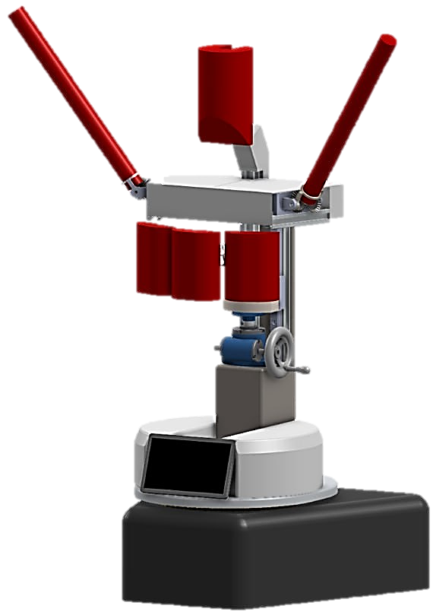
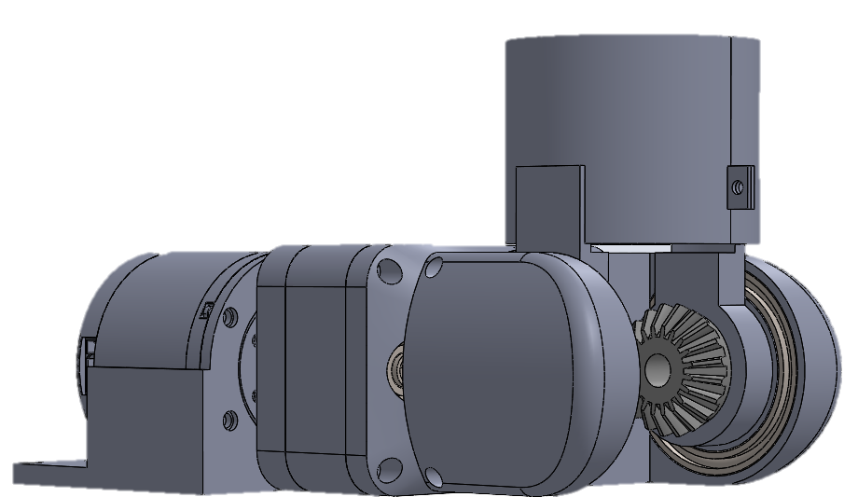

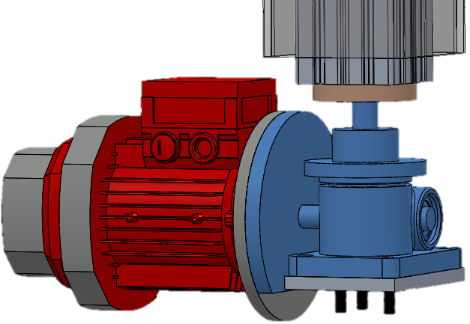



Solution: BoxBunny
Problem
An Intelligent Boxing Trainer
"How might we design an intelligent boxing training system that can dynamically & safely strike users while assisting coaches in guiding, monitoring, & sustaining boxer development both during & beyond training sessions.”
Soft Contact Points
of boxers struggle to stay consistent when progress feels slow or unclear
Polyethylene Foam punching contact points so boxers can punch and get punched without injury
2-DoF Arms
2 Degree-of-Freedom arm-mount that replicates training with boxing sticks used in training
Height Adjustment
of boxers struggle to stay consistent when progress feels slow or unclear
Height-adjustable to accommodate boxers of varying heights
AI-Enabled Training
48%
of boxers struggle to stay consistent when progress feels slow or unclear
of boxers struggle to stay consistent when progress feels slow or unclear
Uses Computer Vision to track, learn, and react to your punches.
44%
of boxers face unreliable or unsuitable sparring partners
Sparring Partner: Reads and reacts to your attacks and defenses realistically
Key
Features
Punch Combinations: Curated selection of punches to learn and level up with
36%
of boxers fear the high risk of injury during training
Safe Environment: Train and spar with all your might without the risk of injuries
Muhammad Zakir Haziq | Engineering Science Programme
Ng Jun Hao, Elgin | Engineering Science Programme
Sim Yu Jeanette | Engineering Science Programme
Muthukumaran Yogeeswaran | Engineering Science Programme

